Slide 1
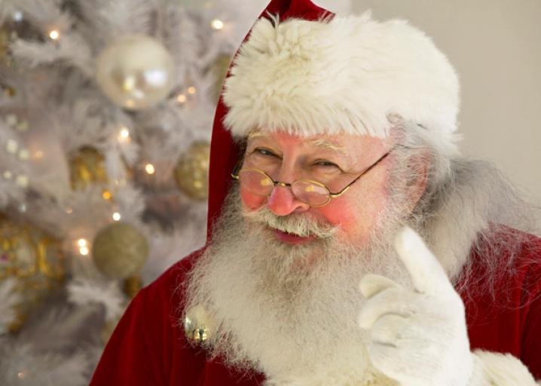
Virginia’s Convolutional Neural Network Using Python And Keras

Slide 2
Purpose - Yes Virginia, There Is A Santa Claus!!
Is it Santa Claus??
Machine Learning image assessment model (Convolutional Neural Network w/ LeNet architecture)
Trained to determine, with a percent confidence, if an image is Santa Claus or not
Website front-end with capability of taking image imput and returning prediction

Slide 3
Additional Slides – As Desired
Dave – Web Development or whatever
Emma – API Connections / Functionality or whatever
Matt – Integration or whatever
Mike – Data Munging or whatever

Slide 4
Convolutional Neural Networks
A class of deep neural networks, applied to analyzing visual imagery
Uses little pre-processing compared to other image classification algorithms.
Independently learns the filters of traditional hand-engineered algorithms.
Independence of prior knowledge / human effort is a major advantage.

Slide 5
LeNet Architecture
One of the first convolutional neural networks
Helped propel the field of Deep Learning
Originally used for character recognition

Slide 6
Applications - Convolutional Neural Networks
Image and video recognition
Recommender systems
Image classification
Medical image analysis
Natural language processing.

Slide 7
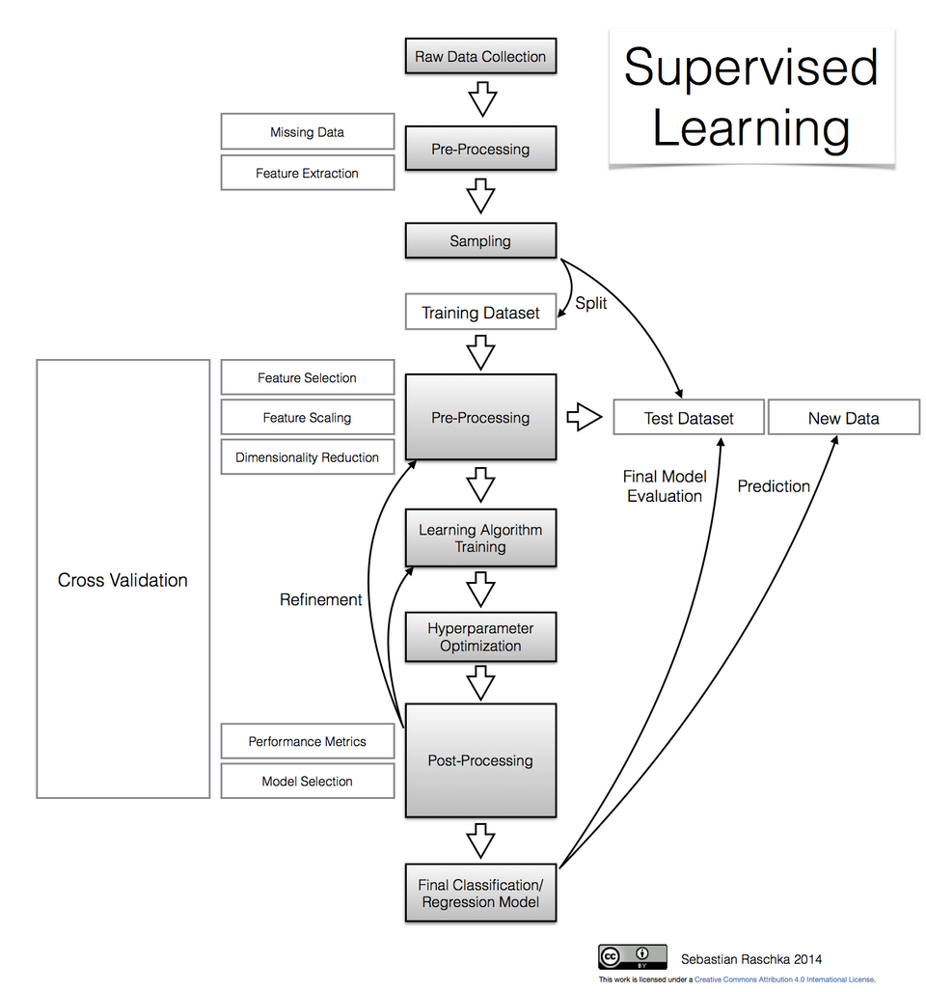
CNN Learning process

Slide 8
Image Data Sets
Image Gathering – Three Sets:
Downloaded from Google image searches in batches
Initial Scrubbing to remove faulty / duplicate images
Initial net images:
Santa – pictures and illustrations (550)
White Beards – various men with white beards (300)
Random – miscellaneous images –no Santa’s or White Beards (1000)

Slide 9
Image Data Sets
Munging
Not all image types would process with CNN program
JPEG image type worked consistently (virtually all of the time)
Read data sets multiple times to weed out last few faulty images
Santa – pictures and illustrations (???)
White Beards – various men with white beards (???)
Random – miscellaneous images –no Santa’s or White Beards (???)

Slide 10
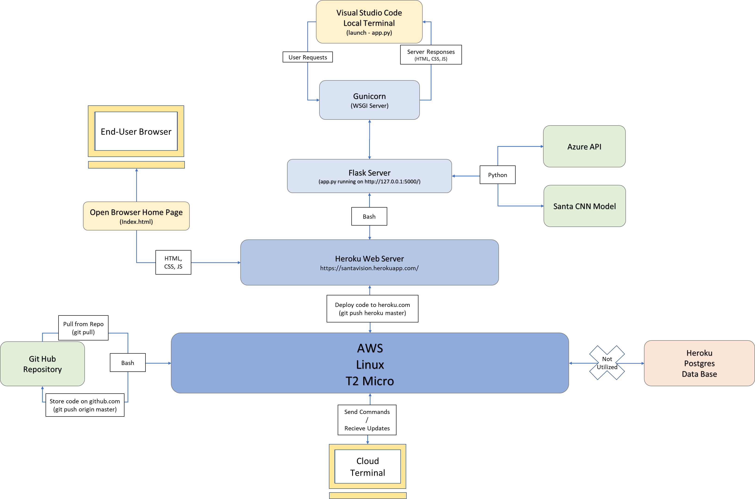
CNN System Architecture

Slide 11
Future Uses of Virginia’s CNN
Construct “SMART” family photo album
Hundreds of family images from various family members
Train on subsets for different characteristics / classes
Develop web based album for extended family member search / download

Slide 12
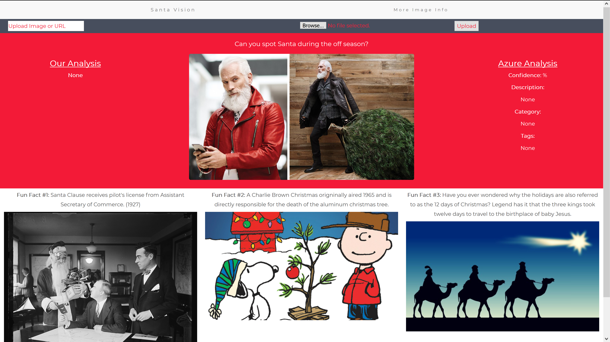
https://santavision.herokuapp.com/

Slide 13
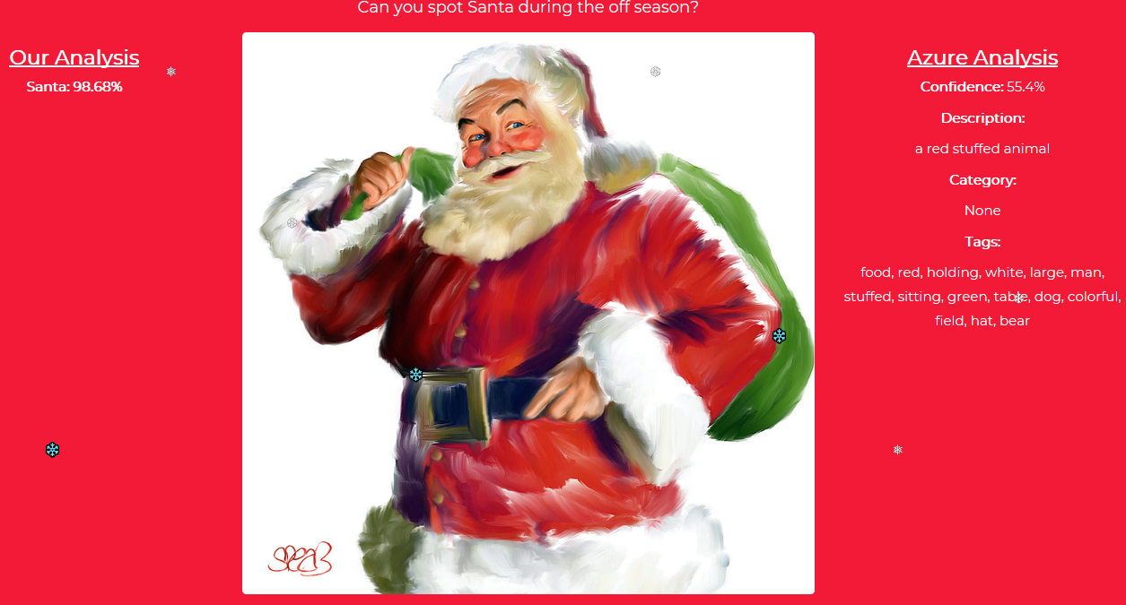
Good Predictive Results…

Slide 14
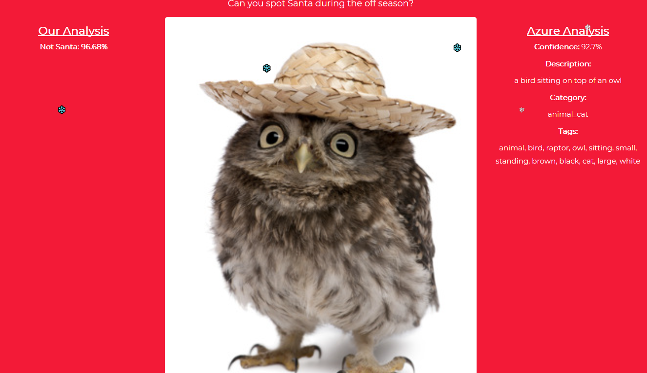
Good Predictive Results…

Slide 15
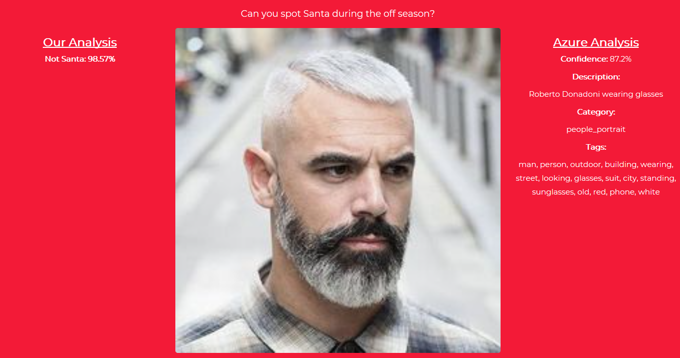
Good Predictive Results…

Slide 16
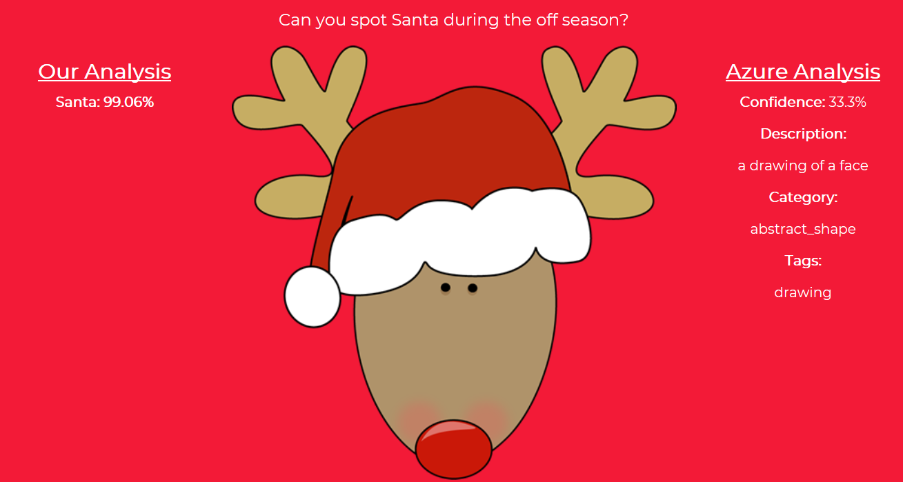
But Not Perfect…

Slide 17
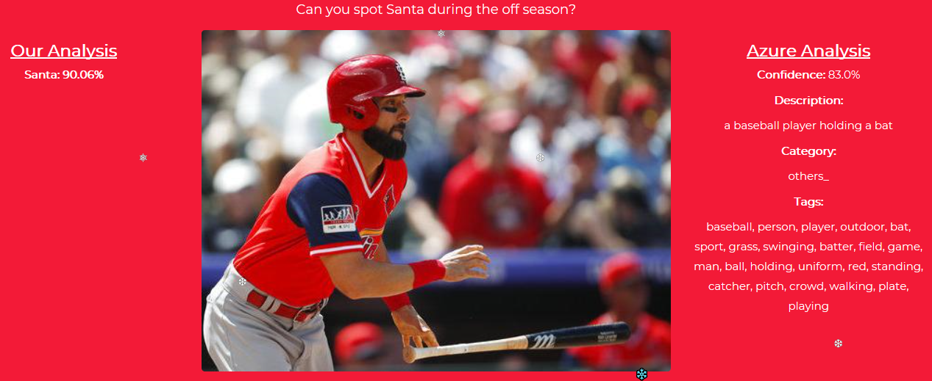
Really Not Perfect…

